Slide 1






Richmond Heights
The Power Of Tomorrow
4th July, 2025
Intelligent Smart Buildings
Prepared by
Shamsul Bahari Bin Zainudin
Website: www.Richmond-height.com
Email: Shamsul@Richmond-heights.com
Go Green

Slide 2
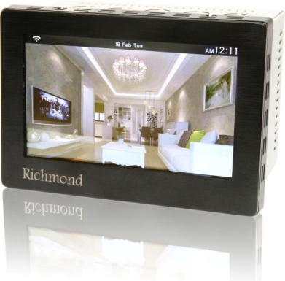
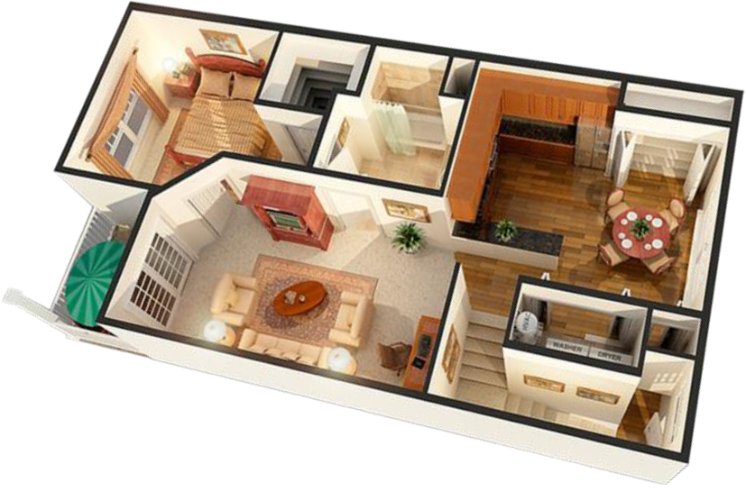
Intelligent Smart Buildings
A smart home can be defined as a home that managed by using apps and remote controls over cables or a Wi-Fi network. It includes multiple functional systems, monitoring devices, and sensors, providing to the owners with comfort and security, as well as energy efficiency and ease of performing tasks.
Website: www.Richmond-height.com , Email: Shamsul@Richmond-heights.com
Go Green

Slide 3
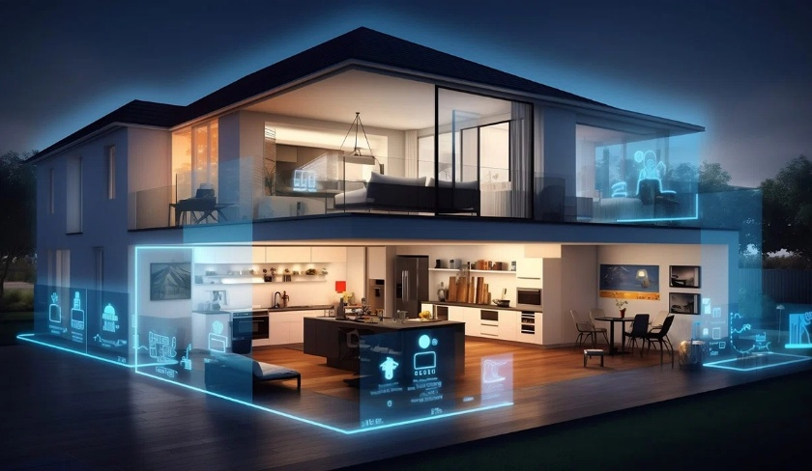
Intelligent Smart Buildings
The concept of designing smart buildings for apartments, villas, hotels, companies, etc. to including all existing electrical/mechanical equipment's, as the system use can be through the touch screens that automatically switch to different programs according to the pre-programming, including, but not limited to, the following:
Website: www.Richmond-height.com , Email: Shamsul@Richmond-heights.com
Go Green

Slide 4
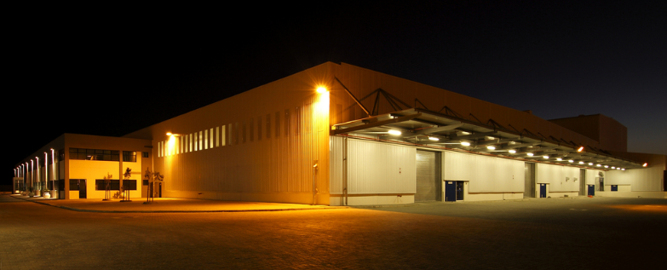
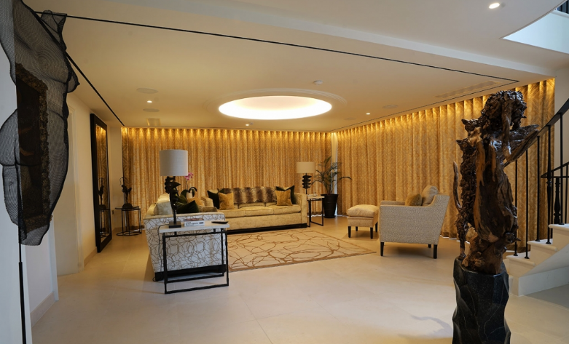
Intelligent Smart Buildings
Indoor and outdoor lighting, whether dimming or on/off
Website: www.Richmond-height.com , Email: Shamsul@Richmond-heights.com
Go Green

Slide 5
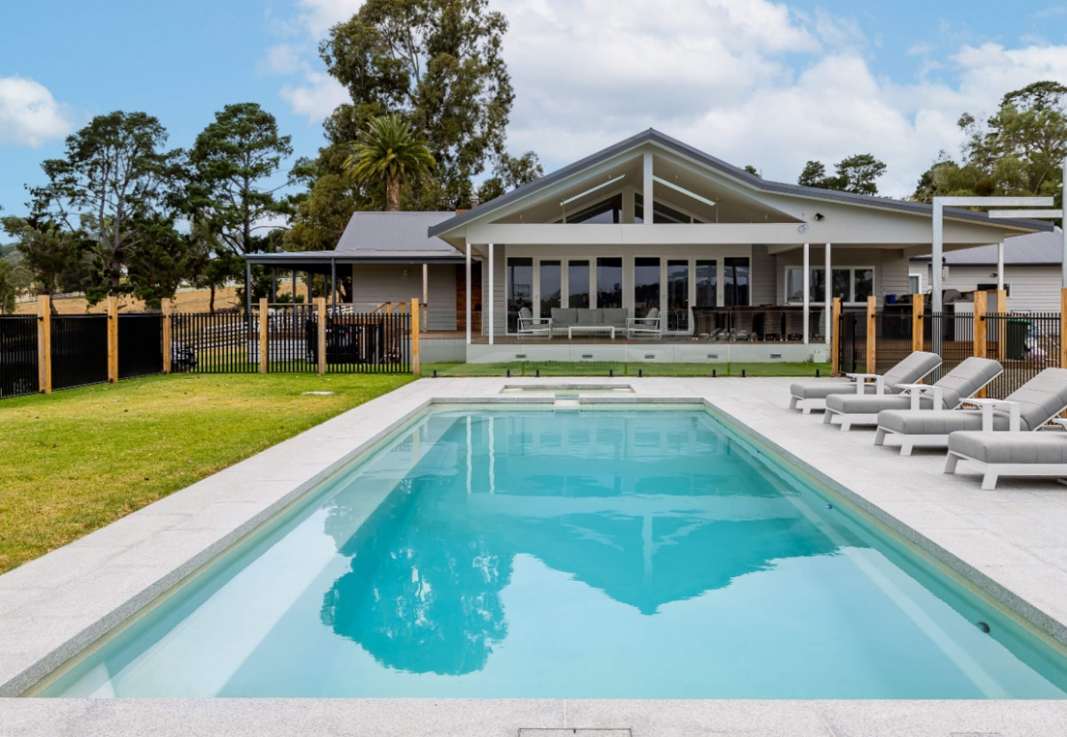
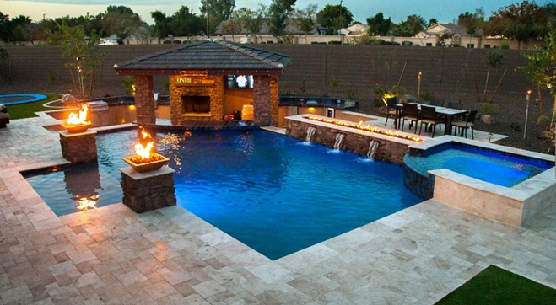
Intelligent Smart Buildings
swimming pools
Website: www.Richmond-height.com , Email: Shamsul@Richmond-heights.com
Go Green

Slide 6
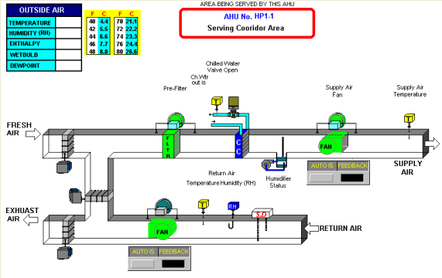
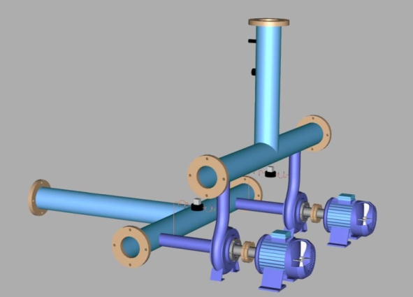
Intelligent Smart Buildings
Central Air Handling Units for hotels, hospitals, towers, etc.
Website: www.Richmond-height.com , Email: Shamsul@Richmond-heights.com
Go Green

Slide 7
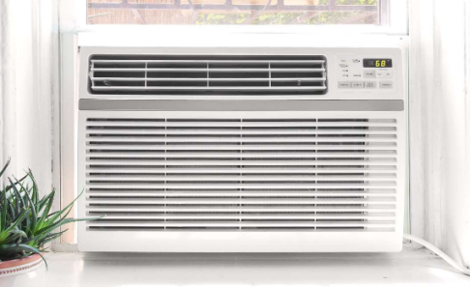

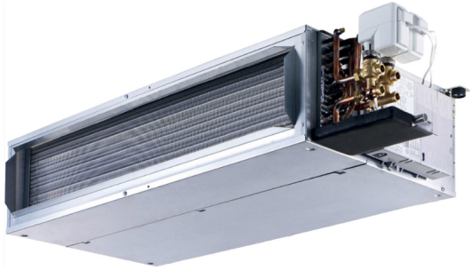
Intelligent Smart Buildings
Air conditioning units of various types: window air conditioners, small central air conditioning units, home air conditioning units (split), etc.
Website: www.Richmond-height.com , Email: Shamsul@Richmond-heights.com
Go Green

Slide 8
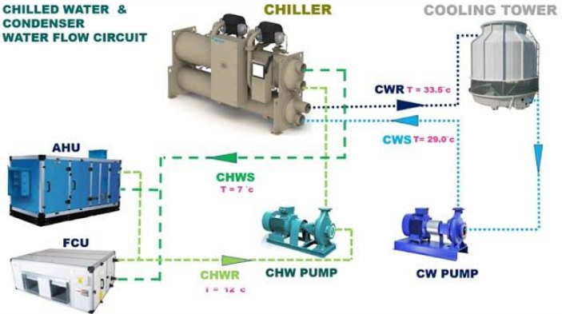
Intelligent Smart Buildings
Central Air Conditioning System / Chillers
Website: www.Richmond-height.com , Email: Shamsul@Richmond-heights.com
Go Green

Slide 9

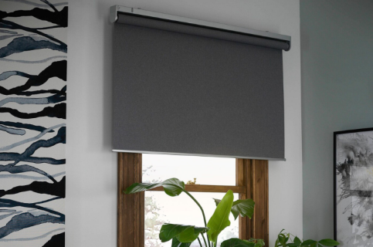
Intelligent Smart Buildings
curtain
Website: www.Richmond-height.com , Email: Shamsul@Richmond-heights.com
Go Green

Slide 10
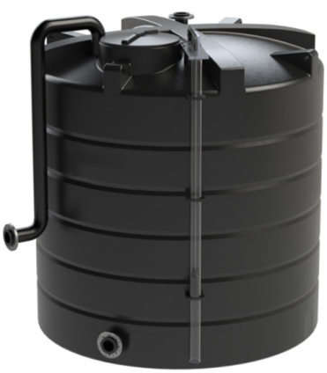
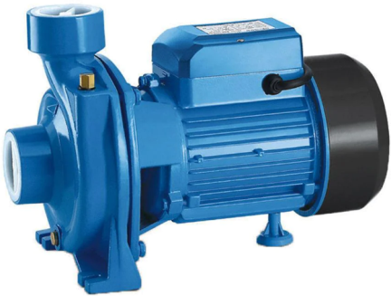
Intelligent Smart Buildings
Water/Diesel pumps and tanks
Website: www.Richmond-height.com , Email: Shamsul@Richmond-heights.com
Go Green

Slide 11
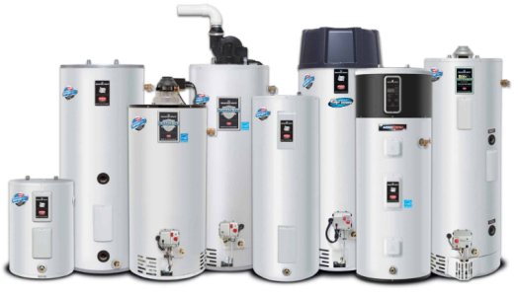
Intelligent Smart Buildings
Water Boiler
Website: www.Richmond-height.com , Email: Shamsul@Richmond-heights.com
Go Green

Slide 12
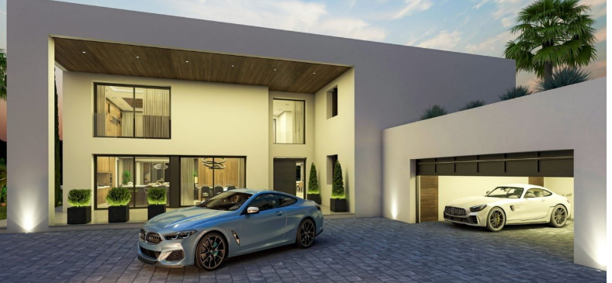
Intelligent Smart Buildings
Cars Garage Gate
Website: www.Richmond-height.com , Email: Shamsul@Richmond-heights.com
Go Green

Slide 13
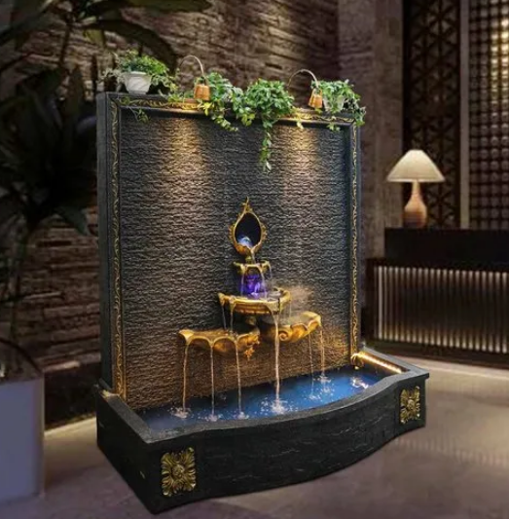
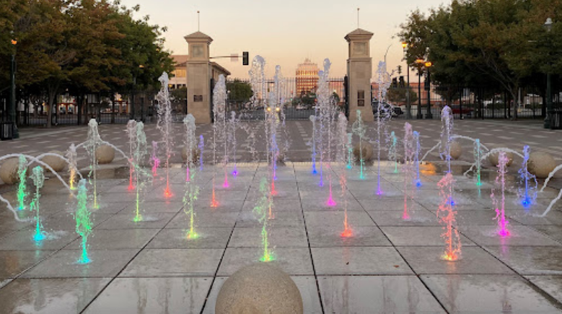
Intelligent Smart Buildings
Internal / External Fountains
Website: www.Richmond-height.com , Email: Shamsul@Richmond-heights.com
Go Green

Slide 14
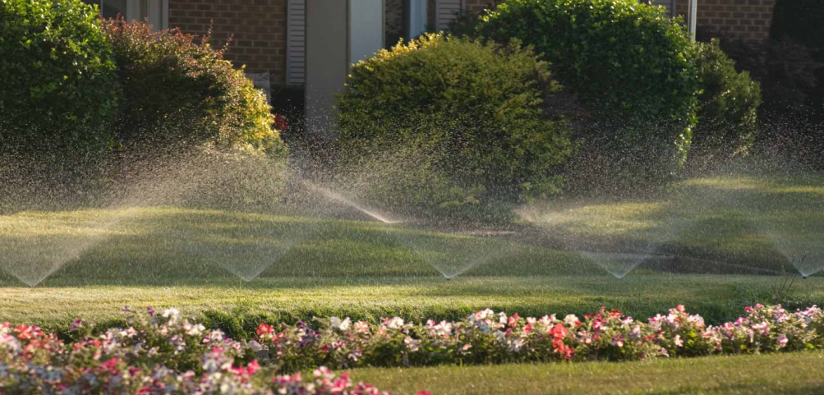

Intelligent Smart Buildings
Gardens Irrigation System
Website: www.Richmond-height.com , Email: Shamsul@Richmond-heights.com
Go Green

Slide 15
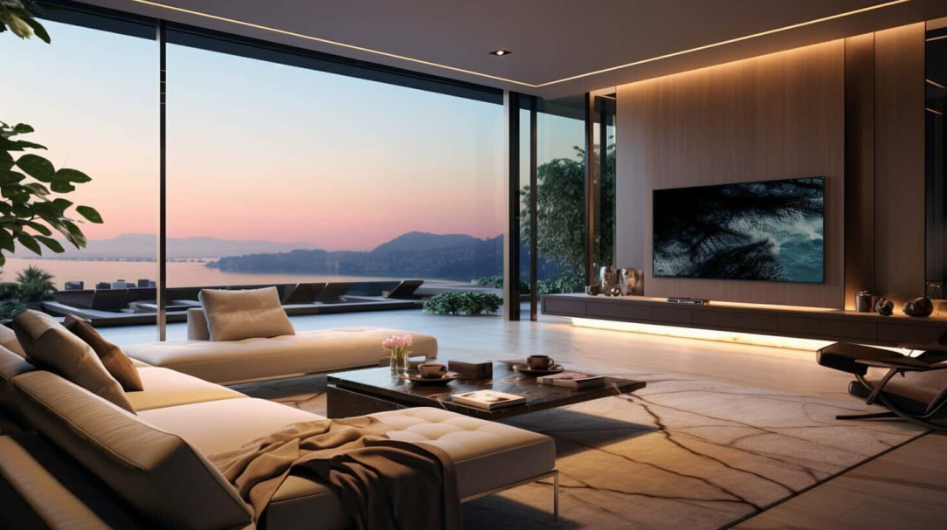
Intelligent Smart Buildings
The system is characterized by ease of installation, programming and operation compared to any similar system. It also does not require a lot of electrical wires installation and does not need to create a network to exchange information between the screens distributed in the facility, as the system is working between all screens via Wi-Fi (Free Installation).
Website: www.Richmond-height.com , Email: Shamsul@Richmond-heights.com
Go Green

Slide 16
Intelligent Smart Buildings
Controller specifications:
The control system screens are similar to 7-inch mobile phone screens.
It can be access from one control screen to another depending on the required area to use it, and make the required changes.
All control devices distributed in the facility/home can operate independently for their own area, and all devices can operate together at the same time according to the required pre-programming.
Website: www.Richmond-height.com , Email: Shamsul@Richmond-heights.com
Go Green

Slide 17
Intelligent Smart Buildings
Controller specifications:
In addition to direct control via screens, residents and users of the facility/home can control all screens distributed throughout all areas via mobile phone.
Residents of the facility/house can control all internal and external lighting, air conditioning, curtains, garage gate, indoor/outdoor fountain, and garden irrigation system from inside or outside the house or from anywhere in the world.
Website: www.Richmond-height.com , Email: Shamsul@Richmond-heights.com
Go Green

Slide 18
Intelligent Smart Buildings
Controller specifications:
It is also possible to control all devices connected to the system by pre-programming all the internal and external lighting circuits, air conditioning, curtains, garage gate, and external fountain, using the time programming feature.
Website: www.Richmond-height.com , Email: Shamsul@Richmond-heights.com
Go Green

Slide 19
Intelligent Smart Buildings
Controller specifications:
System accept a Wide Range Power Supply (110 Vac – 230 Vac) +/- 10%
System Can Directly Control Motors Up To 13 Ampere
Website: www.Richmond-height.com , Email: Shamsul@Richmond-heights.com
Go Green

Slide 20
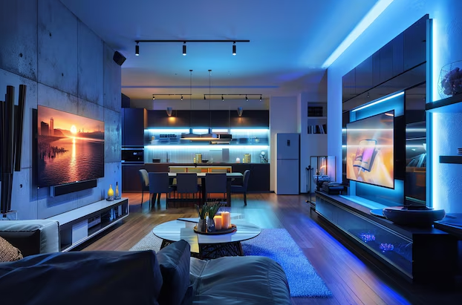
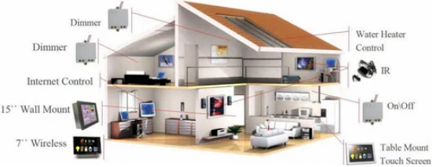
Intelligent Smart Buildings
Website: www.Richmond-height.com , Email: Shamsul@Richmond-heights.com
Go Green

Slide 21
Intelligent Smart Buildings
Power Saving:
Power is falling in more directions than ever
Buildings demand more
Electrification accelerates, and consistent uptime matters every day
What if your building didn’t just use energy, but actively managed it
DAS-G01 makes it easier to integrate renewables, energy storage, and EV charging into commercial facility
Website: www.Richmond-height.com , Email: Shamsul@Richmond-heights.com
Go Green

Slide 22
Intelligent Smart Buildings
Power Saving:
Buildings already account for more than 30% of global energy use
and consumption is projected to climb as the electrification of everything increases
Preparing now means lower carbon, lower cost and higher resilience
Buildings as a grid combines local generation, storage and intelligent control to optimise when, where and how power is used
Website: www.Richmond-height.com , Email: Shamsul@Richmond-heights.com
Go Green

Slide 23
Ready to Transform Your Building into an Intelligent Energy Hub
Intelligent Smart Buildings
Power Saving:
Start with pieces you need to control the power consumption today and scale and enjoy a Centralized Command Centre for your facilities
Our hardware and software are built to integrate and grow
Redefine what your energy system can achieve
Cut carbon and energy costs, improve resilience behind and in front of the meter and create new revenue with grid interactive asset
Ready to Transform Your Building into an Intelligent Energy Hub!
Website: www.Richmond-height.com , Email: Shamsul@Richmond-heights.com
Go Green

Slide 24

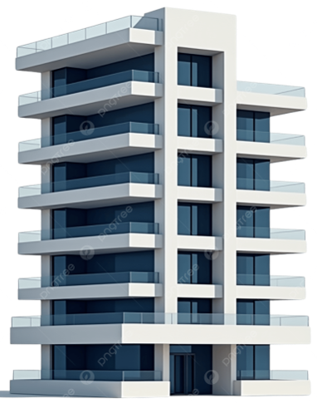
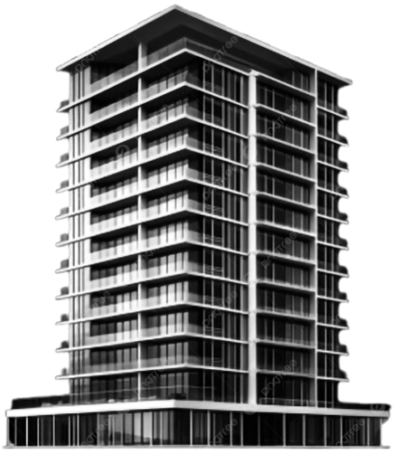
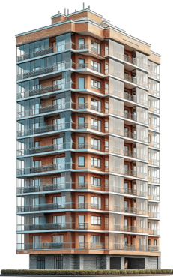
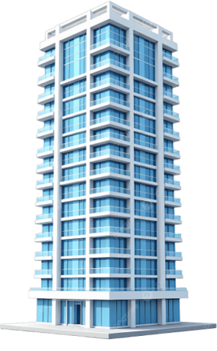

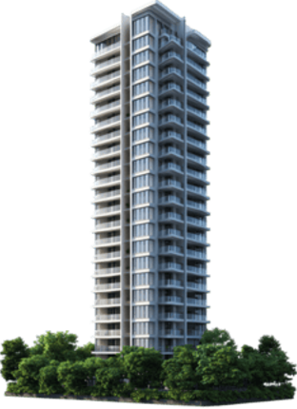
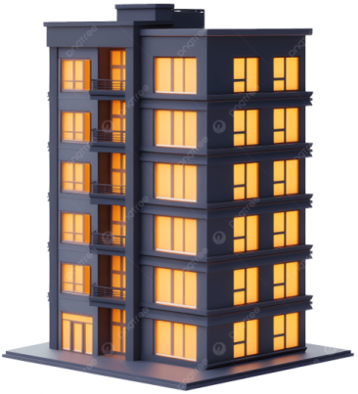


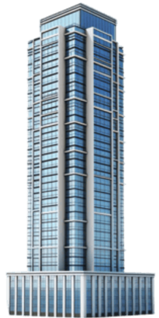
Ready to Transform Your Building into an Intelligent Energy Hub
Intelligent Smart Buildings
Centralized Power Saving Command Center
Centralized Command Center
Website: www.Richmond-height.com , Email: Shamsul@Richmond-heights.com
Go Green

Slide 25
Intelligent Smart Buildings
Controller specifications:
The system is easy to connect to the mobile phone, and villa residents can isolate anyone connected to the system by changing the mobile service password.
The system can be connected to any BMS system (if available) without any additional costs for containments, cables, software or server, as the connection is done via Wi-Fi.
Website: www.Richmond-height.com , Email: Shamsul@Richmond-heights.com
Go Green

Slide 26

Intelligent Smart Buildings
Controller specifications:
The system can be programmed to call the servant to the desired location, whether from the bedroom, living room, or any other place in the home/palace/office.
Website: www.Richmond-height.com , Email: Shamsul@Richmond-heights.com
Go Green

Slide 27
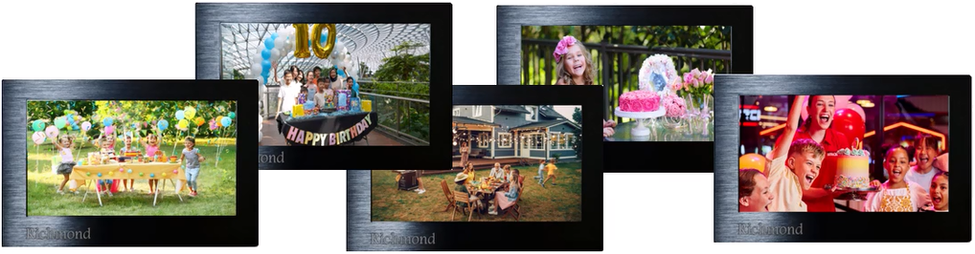
Intelligent Smart Buildings
Controller specifications:
Family photos or company project photos can also be displayed on the control screens, with a maximum of 10 photos per screen.
Website: www.Richmond-height.com , Email: Shamsul@Richmond-heights.com
Go Green

Slide 28
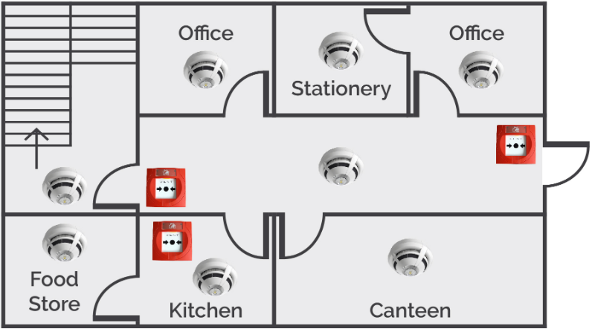
Intelligent Smart Buildings
Controller specifications:
The system can be used to detect fires by adding fire devices such as heat and smoke sensors to homes and creating the appropriate scenario to deal with them.
Note: Connecting fire equipment is not considered an alternative to a fire alarm system approved by the Civil Defense!
Website: www.Richmond-height.com , Email: Shamsul@Richmond-heights.com
Go Green

Slide 29

Intelligent Smart Buildings
Controller specifications:
The system can be used as Nurse Calling System to serve patients in hospitals or homes.
Website: www.Richmond-height.com , Email: Shamsul@Richmond-heights.com
Go Green

Slide 30

Intelligent Smart Buildings
Controller specifications:
The system can be programmed as an early warning device to combat thefts, and to feel safe protected by adding security devices in homes/companies such as motion detectors, infrared rays, etc. and creating the appropriate scenario to deal with it.
Website: www.Richmond-height.com , Email: Shamsul@Richmond-heights.com
Go Green

Slide 31


Intelligent Smart Buildings
Controller specifications:
The control system contributes to rationalizing energy consumption in homes or any facility, and extending the life of electrical/mechanical devices connected to the system. The system is also considered environmentally friendly.
Website: www.Richmond-height.com , Email: Shamsul@Richmond-heights.com
Go Green

Slide 32
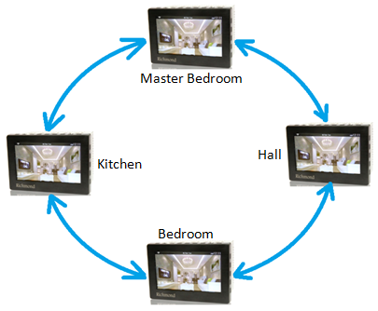
Intelligent Smart Buildings
Special Features Control System / DAS-G01:
Communication between all controllers is done via dual standard protocols such as BACnet/Modbus in Simultaneous with Wi-Fi.
Browsing between different screens
It is used in building control systems such as towers, hotels, hospitals, factories, etc.
BACNet/ Modbus/ Wi-Fi
All Controllers are Master
Website: www.Richmond-height.com , Email: Shamsul@Richmond-heights.com
Go Green

Slide 33
Intelligent Smart Buildings
Special Features Control System / DAS-G01:
All controllers work as a Masters.
It is used for Lighting Control System
It is used for Made Calling System
It is used for Nurse Calling System
It is used for Gardens Irrigation System
BACNet/ Modbus/ Wi-Fi
All Controllers are Master
Website: www.Richmond-height.com , Email: Shamsul@Richmond-heights.com
Go Green

Slide 34
Intelligent Smart Buildings
Special Features Control System / DAS-G01:
It is used for Swimming Pool Control System
It can be used as Fire Alarm & Security System (by adding fire and security devices)
BACNet/ Modbus/ Wi-Fi
All Controllers are Master
Website: www.Richmond-height.com , Email: Shamsul@Richmond-heights.com
Go Green

Slide 35
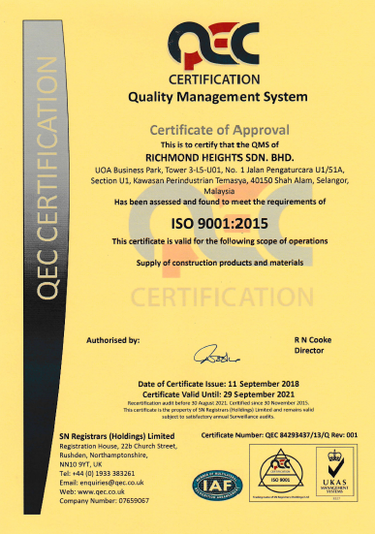

Richmond Heights ISO Certificate 9001:2008
Quality Management System
Certificate Of Approval
ISO 9001:2015
Supply Of Construction Products And Materials
QEC 84293437/13/Q Rev: 001
Website: www.Richmond-height.com , Email: Shamsul@Richmond-heights.com
Go Green

Slide 36
Intelligent Smart Buildings
DAS-G01
The Power Of Tomorrow
Website: www.Richmond-height.com , Email: Shamsul@Richmond-heights.com
Go Green

Slide 37
Questions & Answers
Website: www.Richmond-height.com , Email: Shamsul@Richmond-heights.com
Go Green

Slide 38
Thank You
Website: www.Richmond-height.com , Email: Shamsul@Richmond-heights.com
Go Green

